Slide 1

title
Application Overview
Developed by:
Kyryl Andreiev, Henadzi Kirykovich, Tri Nguyen, and Shayla Rohrer

Slide 2
Our Team
Kyryl Andreiev
Project Manager | DevOps | CI/CD Setup | Deployment
Additional tasks: sprint planning, team coordination
Henadzi Kirykovich
Backend Developer | Frontend Developer | Database Design
Additional Tasks: API development, server logic, React Native components
Shayla Rohrer
UI/UX Designer | Frontend Developer | User Interface Design
Additional Tasks: user experience research, prototyping, design systems, React Native components
Tri Nguyen
QA Engineer | Frontend Developer | Testing Strategy
Additional Tasks: quality assurance, bug tracking, React Native development

Slide 3

the power of communication
App Overview
What is WellMind?
A mobile mental wellness app that supports goal setting, mood logging, and journaling. WellMind is for anyone looking for a mental wellness app.
Built With:
React Native + Expo
Supabase
AsyncStorage
React Context API

Slide 4

the power of communication
Design Inspiration
Color Palette:
Our app uses a calming balance of cool and warm toned pinks and purples.
Visual Style:
By using soft, simple shapes and clear text styles we aimed to create a soothing, non-intrusive space that encourages reflection, emotional clarity, and daily mindfulness.

Slide 5

the power of communication
Navigation & Global State
Navigation:
Uses Expo Router for screen transitions and routing.
Global State:
Background color managed via React Context API
Color preference saved with AsyncStorage

Slide 6
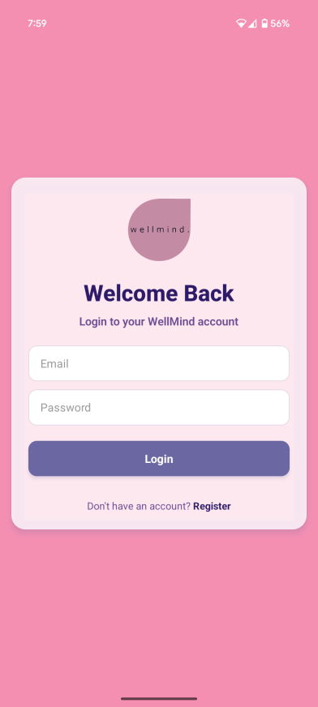
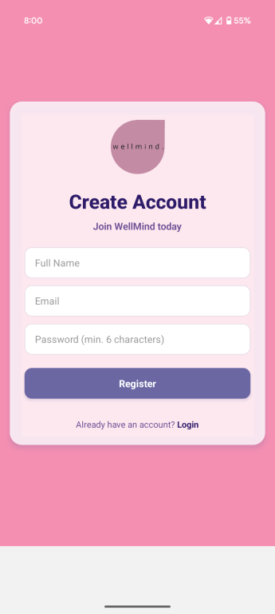
speaking impact
Authentication Screens
Login Features:
Email/password sign-in via Supabase Auth
Link to registration screen
Register Features:
Create account
Redirects to login

Slide 7
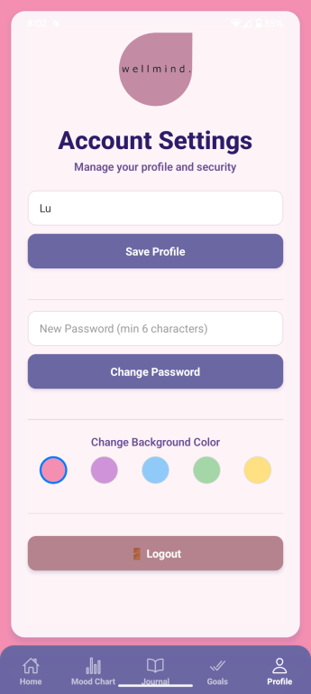
speaking impact
User Profile
Profile Form Features:
View/update full name (Supabase DB)
Change password (Supabase Auth)
Choose app background color (AsyncStorage + Context API)
Logout button (Supabase session end)

Slide 8
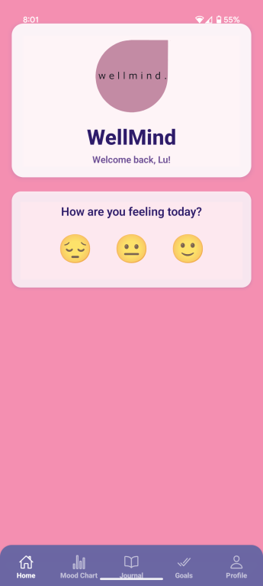
speaking impact
Home Screen
Personalized Greeting:
Pulls user's name from Supabase
Main Daily Goal Display:
Shows and fetches goal from Supabase
Mood Logging:
Saves user mood to Supabase

Slide 9
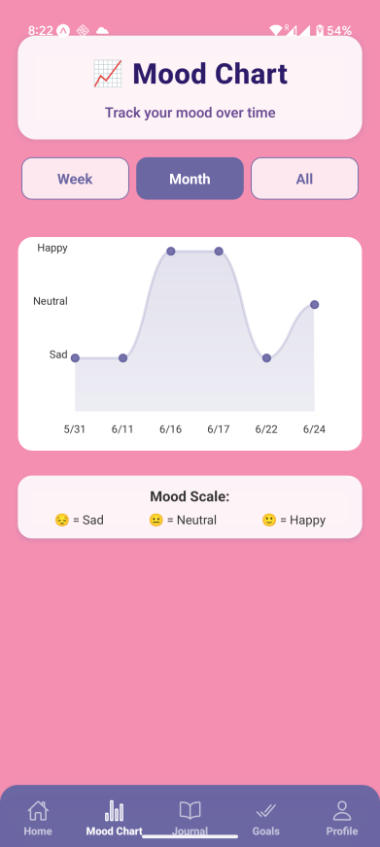
speaking impact
Mood Graph
Mood History Chart:
Line chart with react-native-chart-kit
Filter by Date Range:
Week, month, all-time
Legend Included:
Uses native React Native components

Slide 10
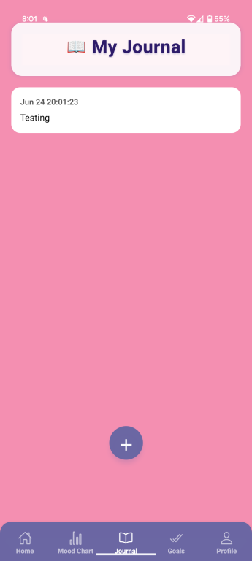
speaking impact
Journal
List of Entries:
Uses data from Supabase
Navigation to Edit:
Taps take you to edit screen

Slide 11
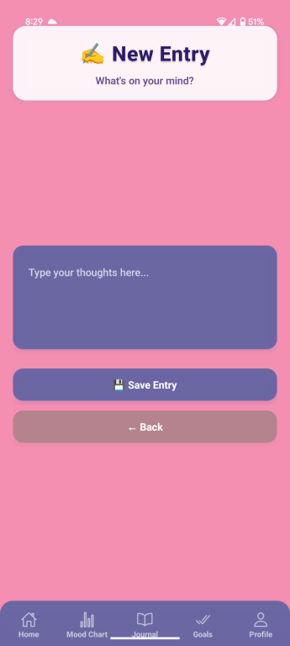
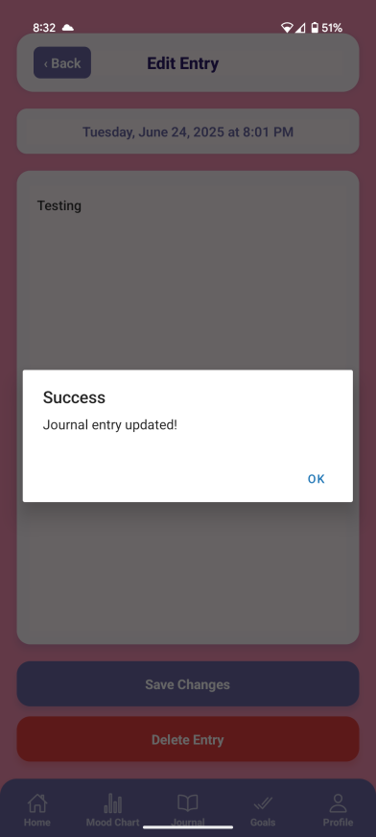
speaking impact
New/Edit Journal Entry
New Entry Form:
Simple TextInput form
Saves to Supabase
Edit Entry:
Modify or delete
Updates/deletes from Supabase

Slide 12
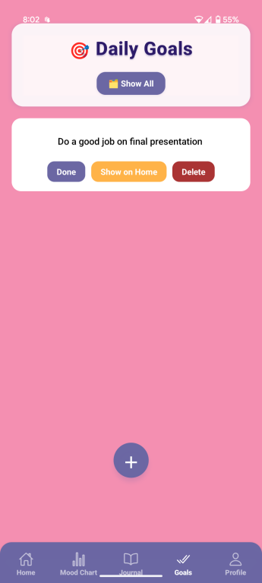
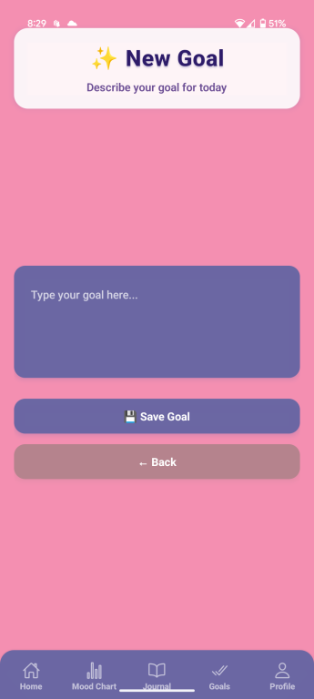
speaking impact
Goals Screen/Add Goal
Goal List Display:
Renders from Supabase
Status & Prioritization:
Mark as 'Done' or 'Main'
Filter:
Toggle todays vs. all goals
Form to Create Goal:
Simple input form
Saves to Supabase

Slide 13

the power of communication
Core App Infrastructure
404 Page:
Friendly 'Not Found' screen with home link
Index Screen:
Entry point
Redirects based on session (Supabase Auth)

Slide 14

the power of communication
Challenges
Time management
Debugging and troubleshooting code
Various personal things such as illness, childcare, and work
We overcame our challenges by communicating regularly with our teammates through discord, sharing the workload, and asking our Professor for help when needed.
Consideration for future projects:
Focus on balancing the distribution of tasks and equalizing the workload for each team member.

Slide 15

Summary
Built with modern tools like Supabase, React Native, and AsyncStorage
Organized screens with personalized, secure user experiences
Prioritizes mental wellness through journaling, goal-setting, and mood tracking

Slide 16
thank you
Thank you

